Slide 1

Jason Kuruzovich & Hammad Ghuman
AT&T Tech Valley Civic App Challenge

Slide 2
Problem
AT&T
Civic App Challenge

Slide 3






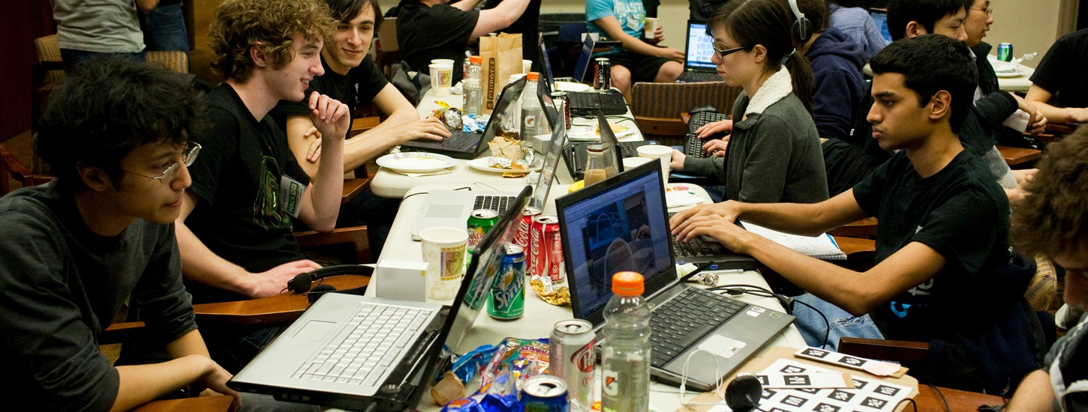



Problem
AT&T
Civic App Challenge

Slide 4
Problem
Have Projects
Need Projects
Nonprofits
Government
Startups
Intellectual Property (Universities & Government)
Developing Countries
Corporations
Classes (Experiential Education)
Programs (RPI Center for Open Source Software, Change the World Challenge)
Students and Professionals Looking to Develop a Portfolio
Notes:
Issue hear is reall much broader

Slide 5
Project Hunt helps connect hackers, makers, designers, hustlers, and students with projects that matter.

Slide 6
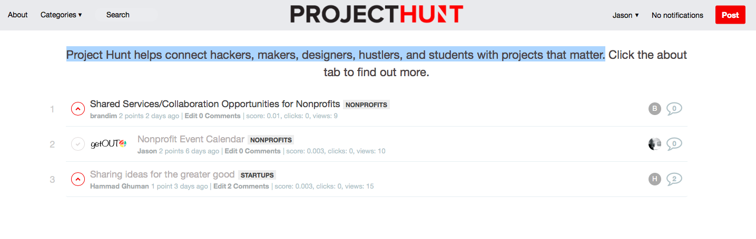
Solution
Project posting
Filtering/Voting/Comments
Social Links/Profiles

Slide 7



Deployment
Responsive Web Portal
Live at projecthunt.org
Android App (Deployed via Hocke)
IPhone App (Completed, but not deployed)
Windows, Blackberry etc. easy deployment
-

